Slide 1
Uber Supply-Demand Gap
Vanraj Dinesh Bohra
Email : vanrajbohra@gmail.com
March 2022

Slide 2
Agenda
Business Problem Statement
EDA
Analysis / Findings
Recommendation

Slide 3
Business Problem Statement
Problem Statement:
Root Cause Analysis for following problems between Airport and City resulting in loss of potential revenue:
Non-Availability of Cabs
Driver Cancellation
Analysis Objective:
Identify Root Cause for given problem Statement.
Possible Hypothesis for Problem.
Recommend Solution in order to reduce Supply and Demand Gap.
Data to Analyze:
6745 Rides detail for 13th Sept 2016 to 15th Sept 2016 between Airport and City
All Rides are classified as Completed, No Car Available and Cancelled

Slide 4
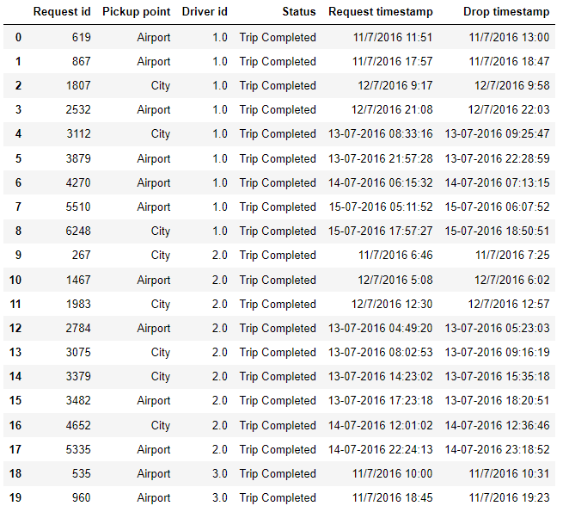
EDA : Data Cleansing
Dataset contain following Columns:
Request ID(Primary Key)
Pickup Point
Driver ID
Status
Request Timestamp
Drop Timestamp
Data Cleansing on above Columns:
Checked Duplicate column if available in given dataset
Null handling
Request and Drop timestamps where not in consistent format, so have changed It to consistent format.

Slide 5
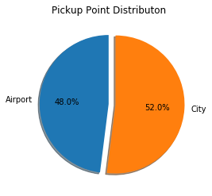
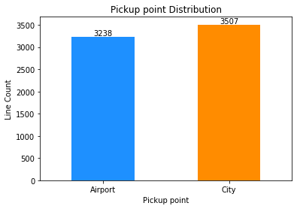
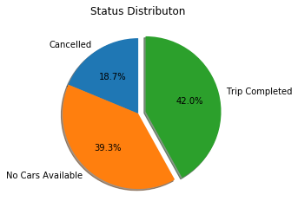
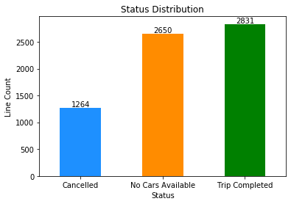
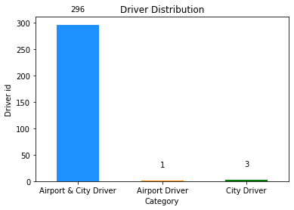
Analysis : Univariate Analysis
Pickup Point :
Show we have almost equal distribution of ride between Airport and City.
Status :
Only 42% of total Ride is completed
No car Available are equivalent to Trip Completed, so its means that Uber are running Shortage of car
Driver ID:
Total Uber Driver are 300
296 Drives at both Airport as well as City

Slide 6
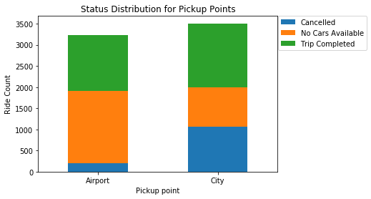
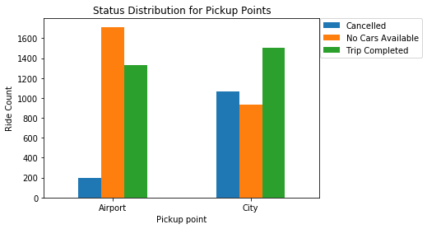
Analysis : Bivariate Analysis
Bivariate Analysis between Status and Pickup Points:
Cars are not available more than Completed rides on Airport which is sheer loss in Revenue.
Cancellation are much done in City.

Slide 7
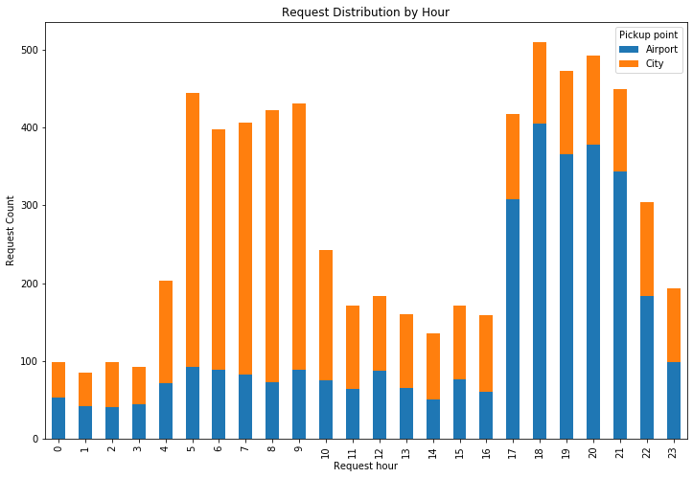
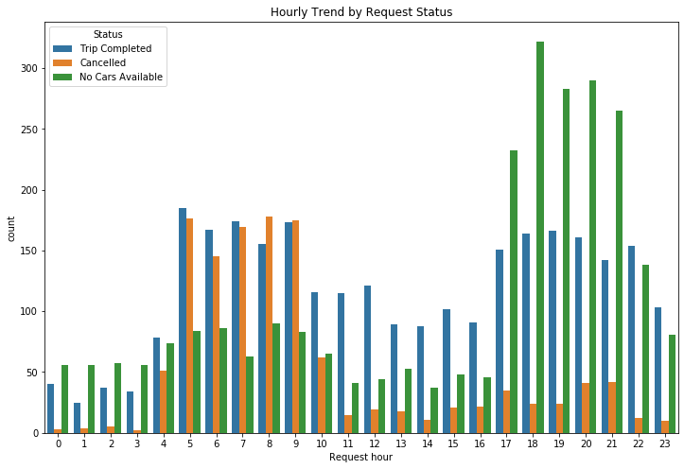
Analysis : Hourly Demand Analysis
On an hourly Trend 5 to 10 and 17 to 22 clearly depicts as Peak hour, where in morning more demand is from City and Evening more Demand is from Airport.
We can also see in morning peak hour Cancellation is more and Evening No Car Available are peaking

Slide 8
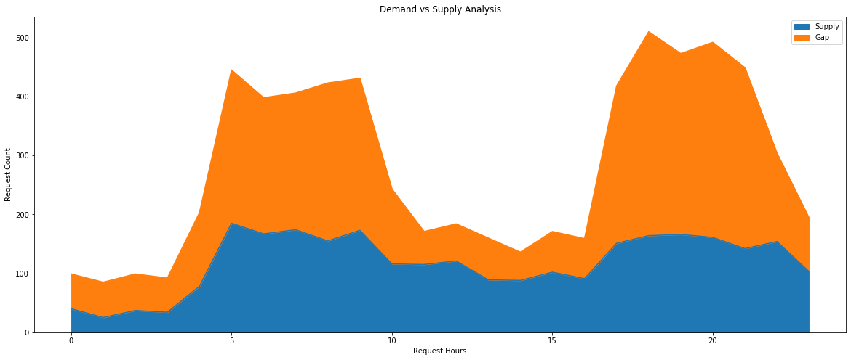
Analysis : Supply and Demand Hourly Trend
Gap between today demand and Supply have been considerably very high during Peak Hours which result in sheer loss of revenue.

Slide 9
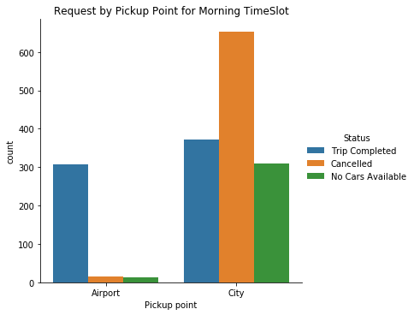
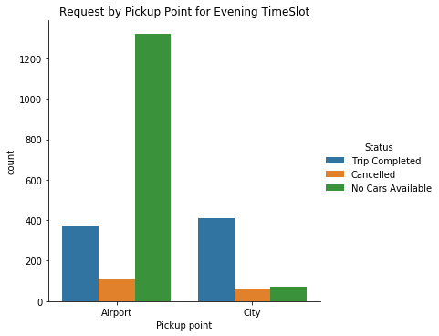
Analysis : Root Cause for Revenue Loss
Higher Number of Cancellation from City in Morning
Potential Reason : Demand is high from City to Airport but vice-versa is not true, hence driver tends to cancel the request as getting a return trip to city will be difficult.
Car Unavailability from Airport in Evening
Potential Reason : Demand is High from Airport but vice versa is not true.

Slide 10
Recommendations
Offer incentives to all city trip pick-up points during morning peak hours and evening peak hours for all airport trip pick-up points.
To fulfill the airport's high demand, additional cab must be introduced.
Penalizing a driver, a fee for canceling a request or restricting a driver's daily cancellations
Ride-sharing (carpooling) services can be quite useful in dealing with the problem of car shortages.
Advance booking is another helpful technique for drivers who want to plan their journey ahead of time, resulting in fewer cancellations.

